Slide 1

Introduction To Sentiment Analysis
Data Science Final Project

Slide 2
Team Members:
Nuthan
Harshita
Jayakrishna
Dwaraka

Slide 3
Sentiment Analysis
Sentiment analysis concentrates on responses and feelings derived from textual data. It is widely utilized in social media analytics and web mining since sentiments are the most important factors in determining how people behave.
Types of Sentiment Analysis
Fine-grained Sentiment Analysis
Emotion Detection
Aspect-based Sentiment Analysis
Multilingual Sentiment Analysis

Slide 4
Importance of Sentiment Analysis
The most important benefit of sentiment analysis is that it makes it possible for you to comprehend how your clients feel about your brand. By automatically assessing the thoughts and sentiments of your customers through social media chats, reviews, polls, and more, you can enhance your goods and services and make better decisions.
Understanding influencers is another application of sentiment analysis. If you've ever wondered who the best influencer to support your upcoming major brand campaign is, sentiment analysis tools can assist you identify them. However, sentiment analysis can also be used to help you find those who might be harming your reputation. This is crucial in the socially focused environment of today, where a single comment or action may instantly affect a business.

Slide 5
How Does Sentiment Analysis Work?
In order to produce key insights on data , we use the combination of Natural Language Processing and machine leaning. This combination helps us to analyse the words and phrases accurately
You can use several sentiment analysis models and algorithms in accordance with the quantity of data and level of accuracy you require in your output. Algorithms for sentiment analysis fall into one of the three categories below.
Rule-Based Approach
Automatic Approach
Hybrid Approach

Slide 6
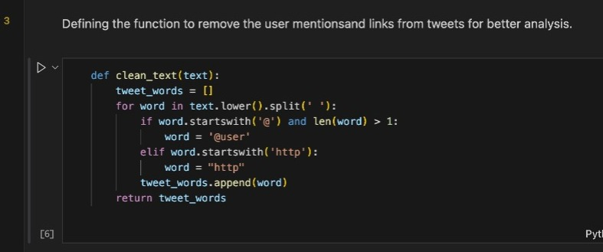
Data Cleaning
Explanation:
Lowercasing: Convert to lowercase for consistent analysis.
Replace User Mentions: Replace with '@user' for anonymization.
Replace URLs: Simplify with "http".
Word Tokenization: Store cleaned words in tweet_words.
Example:
Original Tweet: "Great experience with @username! Check out http://example.com."
Cleaned Tokens: ["great", "experience", "@user", "check", "out", "http"]

Slide 7
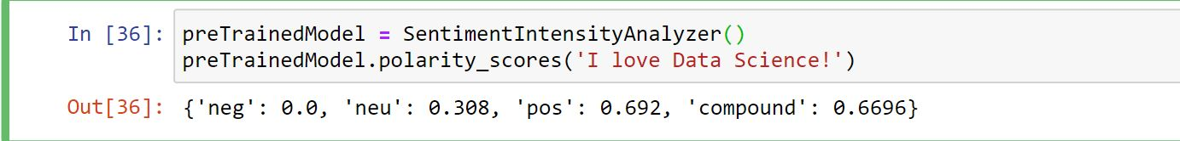
VADER
A model for text sentiment analysis called VADER (Valence Aware Dictionary for Sentiment Reasoning) is sensitive to both the polarity (positive/negative) and intensity (strong) of emotion. It may be used right away on unlabeled text data and is included in the NLTK package.
The VADER sentimental analysis uses a dictionary that converts lexical data into sentiment scores, which measure the intensity of an emotion. By adding the intensity of each word in a text, one can determine the sentiment score of that text.

Slide 8
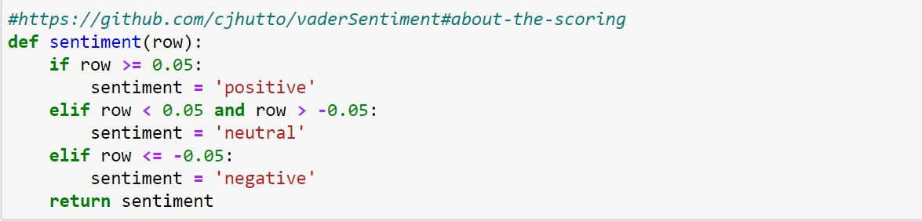
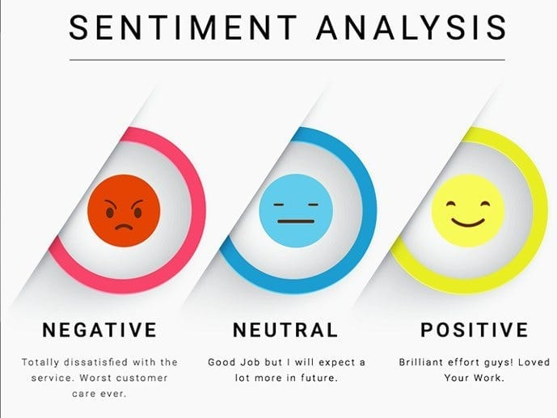
About Polarity
The compound score is calculated by averaging the valence scores of each word in the lexicon, then normalizing it to fall between -1 (the most extreme negative) and +1. (most extreme positive).
If you wish to utilize a single, unidimensional metric to assess the sentiment of a given sentence, this is the best choice. The term "normalized, weighted composite score" is appropriate.
Researchers that want to establish standardized cutoffs for categorizing sentences as either positive, neutral, or negative can also find it useful. The literature listed on this page uses the following typical threshold values:

Slide 9
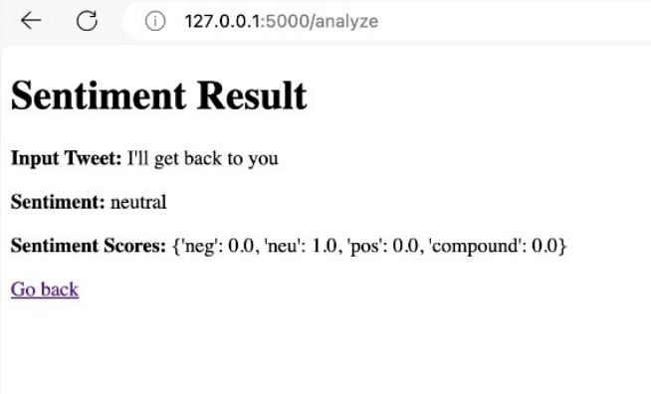
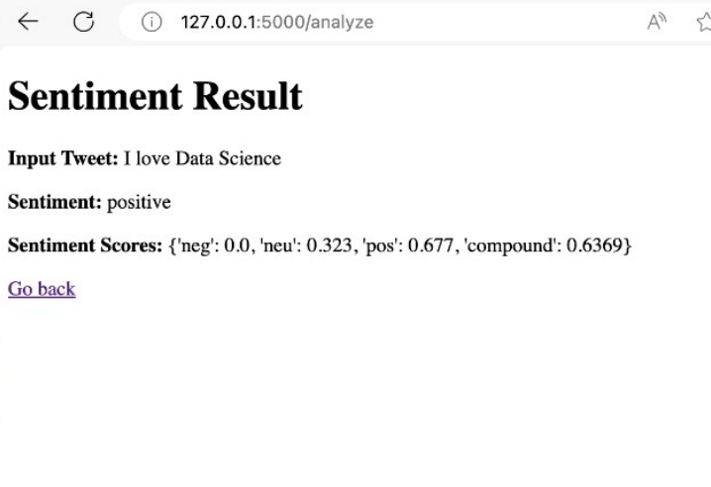
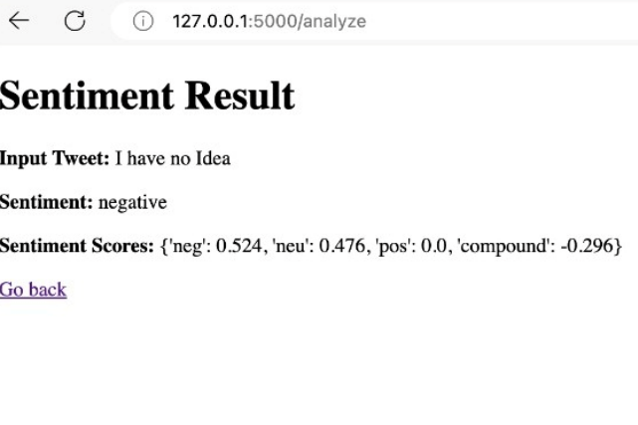
Results
Positive
Negative
Neutral

Slide 10
System Requirements
Any PC /Mac that can run on Jupyter notebook.
Prerequisites
Python Programming
Tools used :Jupyter notebook
Packages like : Numpy, Pandas, Matplotlib, etc..
System Requirements & Prerequisites

Slide 11

Sources :
https://towardsdatascience.com/sentimental-analysis-using-vader-a3415fef7664
https://github.com/cjhutto/vaderSentiment#about-the-scoring
https://youtu.be/uPKnSq6TaAk

Slide 12

Thank You

